Slide 1
Encryption in Java
Java in practice
November 17, 2016

Slide 2
Encryption in Java
Agenda for today
What is encryption
Symmetric encryption
Asymmetric encryption
Certificates
Signature
Hash

Slide 3

What is encryption
Conversion of data from one form to another.
The resulting data is not easily readable.
Only authorized authorities can read the file.
Used to protect confidential data.
Encryption/decryption is performed with the use of a key and an algorithm that defines how the key would be used.
2 types of encryption – symmetric and asymmetric.

Slide 4
Symmetric encryption
One key is used both for encryption and decryption.
Weaker encryption – used for old systems or where a lower level of security is required.
encrypt
decrypt
Sender
Receiver
Shared key
Encrypted file
Shared key
Plain text file
Plain text file

Slide 5
Symmetric encryption
Using with Java
Have a look at javax.crypto.Cipher
Create an instance of the cipher by using the appropriate implementation.
AES – considered secure enough. Use “AES/CBC/NoPadding” and “SunJCE” as provider.
AES – 128 bit key, content is encrypted in 128 bit blocks
Initialize the key with SecretKeySpec – get bytes of the key and use “AES” as algorithm.
Initialize an InitializationVector (IvParameterSpec) – makes original text harder for an attacker to decrypt. Used for the very first block of the text.
Finally run doFinal() method of the cipher.

Slide 6
Asymmetric encryption
Two keys are used – one for encryption and one for decryption.
Certificate – a combination of private and public key
Stronger encryption – used for sensitive data.
encrypt
decrypt
Sender
Receiver
Receiver public key
Encrypted file
Receiver private key
Plain text file
Plain text file

Slide 7
Certificates
Identifies an entity
Consists of public part and a private part
Each certificate contains a key within along with additional metadata– issuer, expiration date, subject, etc.
The certificate is signed – signed means verified.

Slide 8
Certificate Authority
Entity that issues certificates
Used to sign digital certificates
Considered to be a trusted authority
Browsers and devices maintain a list of trusted CAs

Slide 9
Asymmetric encryption
Using with Java
Let’s create a public and private key pair.
Have a look at java.security.KeyPairGenerator
Create RSA keypair. This is most commonly used.
To encrypt and decrypt something with public and private keys just use the same example as with symmetric encryption but just use different keys. In essence – the logic in Java for encryption and decryption does not depend on the type of encryption – it is the keys and algorithm used.
Hint: use algorithm “RSA/ECB/OAEPWithSHA1AndMGF1Padding” for initializing the cipher.
Follow the Oracle guide: https://docs.oracle.com/javase/tutorial/security/apisign/step2.html

Slide 10
Where can we see encryption
Everywhere
What is SSL –a security protocol for establishing a secure link between a server and client. Ever noticed https addresses in the address bar?
client
server
I want to communicate over a secure protocol
Validate certificate
I support this. Here is my public certificate
Generate a key
Encrypt the key
Using the provided certificate
Here is the key I generated
Decrypt the key using my private key.
Secure Connection

Slide 11
Signature
A mechanism for verifying the issuer of a document, request or some data
The private key is used for signing a document and the public key is used for verifying it.
The signature is unique for each different data object – each different file or request.
A so called Message digest is generated from the data and this message digest is encrypted using the private key.
This encrypted content is the signature.
In order to verify the signature, the signature is being decrypted using the public key.
A message digest is created from the document.
If the generated message digest matches the decrypted content – the signature is validated.

Slide 12
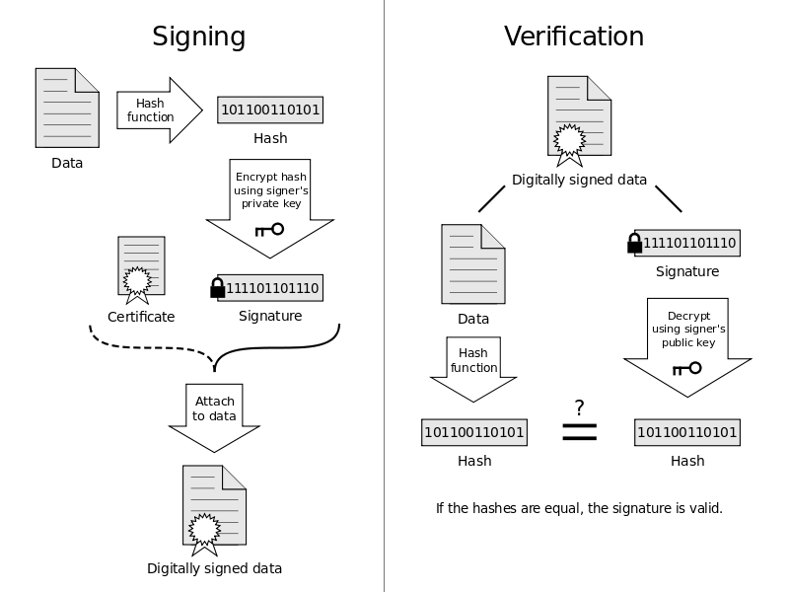
Signature
Diagram

Slide 13
Signature
Use with Java
Have a look at the development guide: https://docs.oracle.com/javase/tutorial/security/apisign/index.html
Use java.security.Signature.
Generate keys pair using the asymmetric RSA algorithm.
Get instance of Signature and specify the signature algorithm – for example “MD5WithRSA”. List of available algorithms can be found here: http://docs.oracle.com/javase/7/docs/technotes/guides/security/StandardNames.html#Signature
Add the data to the Signature object with update().
Initialize signing or verifying with initSign() and initiVerify()
Perform the needed action with sign() or verify().

Slide 14
Hash
Data prepared out of a one-way encryption algorithm – meaning the data can no longer be decrypted.
This is how message digest is created, this is how the most sensitive data should be stored.
The verification should not be performed by decrypting but by validating a generated hash against a saved hash – that way the true form of the original text cannot be stolen.
Or can it? – Rainbow tables. Check already created hashes against a table with precompiled hashes using the same algorithm.
Hash algorithms – MD5, SHA-1, SHA-2.
Use java.security.MessageDigest for preparing hashes.

Slide 15

Questions?

Slide 16
Homework
Assignment: Custom encryption/decryption
By using the principles of symmetric and asymmetric encryption create a command line program that has 2 options – encrypt and decrypt:
Encrypts a file by using symmetric encryption with a randomly generated key. Use a random generator.
The name of the file should be configurable.
The encryption key by itself should be protected and should be encrypted using asymmetric encryption. (Be careful which of the keys will be used for encryption and which for decryption). The generated keys can be stored on the file system.
The output of the encrypt method should be the encrypted file and the encrypted key.
Create a method that decrypts the file. The decrypted file should be saved on the file system.
It should be possible to encrypt and decrypt files between different runs of the program – for example I can run it now and it should encrypt a file. I can then turn it off and run it again 2 hours later and attempt the decrypt. The program should also work with multiple files(I can now encrypt 5 files and later decrypt only 3 of them – figure out a way for storing associations between files and keys)
BONUS: Try figuring out a way to programmatically verify if the decrypted file is successfully decrypted and is the same as the original file. (Hint: use hashes).

Slide 17

Homework
Assignment: Custom encryption/decryption
Diagram of the algorithm below

Slide 18
Thanks for your attention!
Andrey Andreev
aandreev@axway.com

